Slide 1
Mall customer segmentation

Slide 2
Why customers segmentation plays an important role in shopping mall business survival?
Identify potential customers;
Deliver meaningful and impactful campaigns;
Develop customers relationship with more personalized communication;
Increase revenue;

Slide 3
Data Source and Details
Data is acquired from an e-commerce website;
Data contains 200 rows of customer id, gender, age, annual income and spending score;
There is no duplication in data and ;
Null values are taken care of in the process;

Slide 4
Data Exploration and Analysis
Data is analysed from several angles:
Distribution of customers by gender;
Distribution of customers by age;
Distribution of customers by annual income;
Distribution of income by gender;
Distribution of spending score by gender;
Distribution of income against spending score;

Slide 5
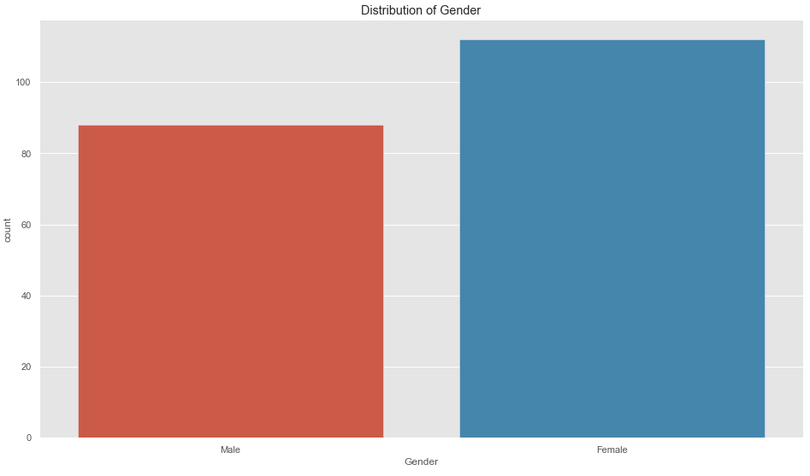
Distribution of customers by gender
Women customers outnumber the male customers by approximately 20,000.

Slide 6
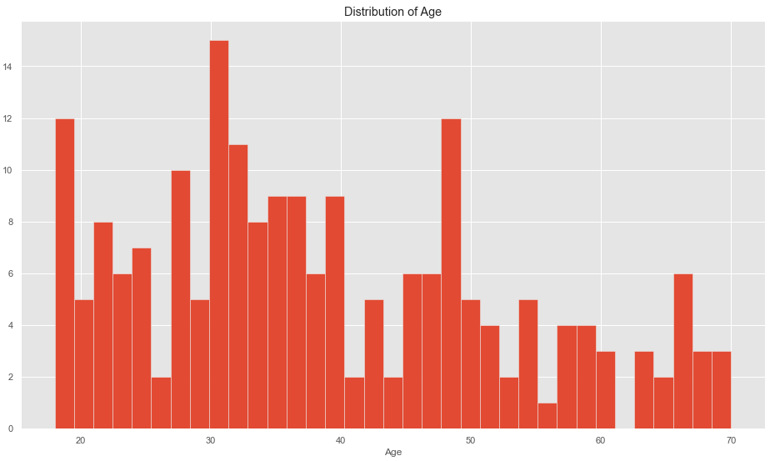
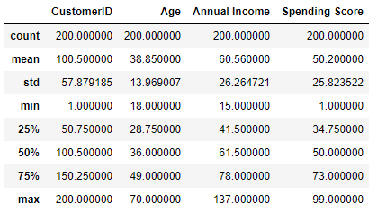
Distribution of customers by age
Most customers fall within the range of 35 and 38. This is line with the data set statistics as shown below.

Slide 7
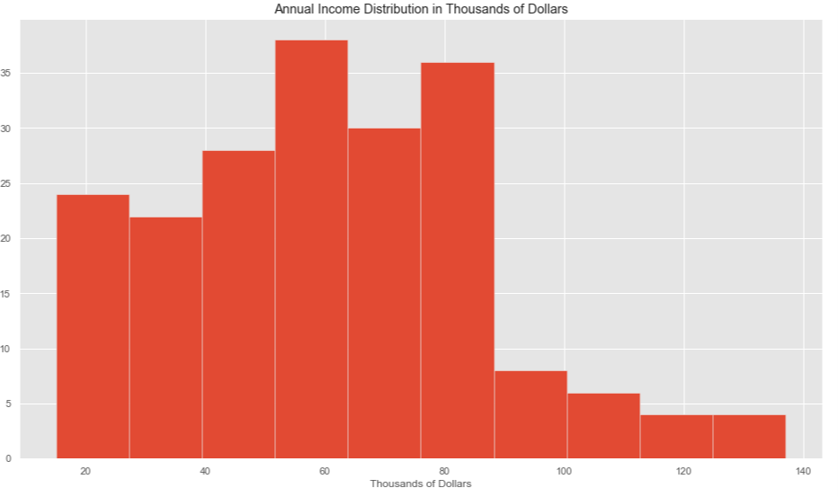
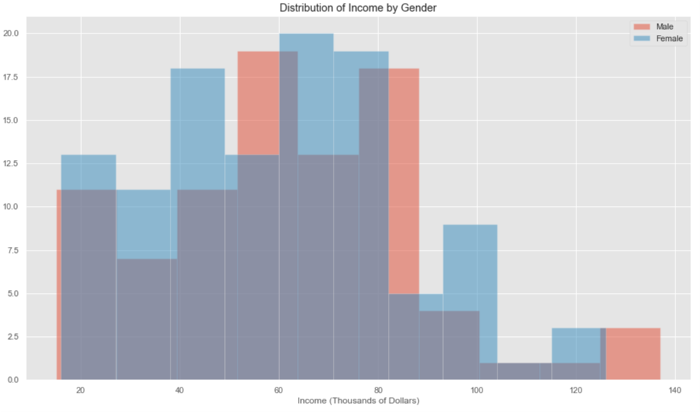
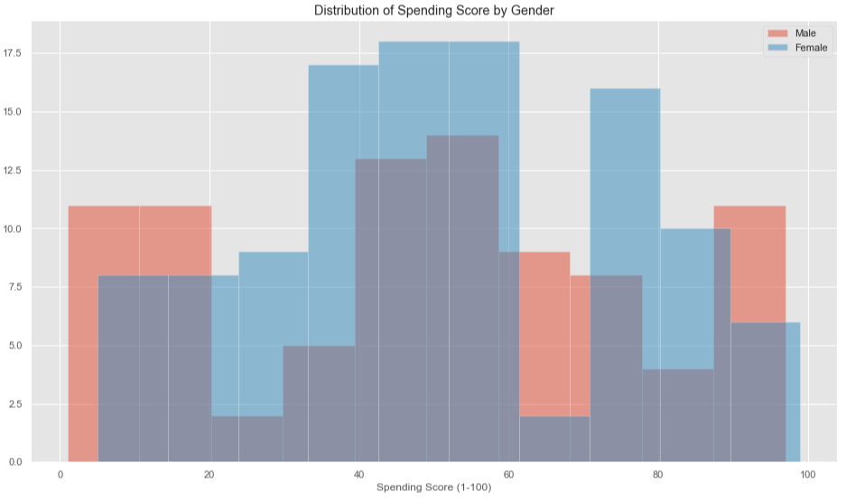
Distribution of Income
Most customers fall within the range of $60,000 and $80,000.
Women slightly lower than men do, and this is line with the data set statistics as shown below.
Annual Income of male customers: $62.28
Annual Income of female customers: $59.25
Despite lower annual income, women have higher spending score, as also shown below.
Spending Score of male customers: 48.51
Spending Score of female customers: 51.53

Slide 8
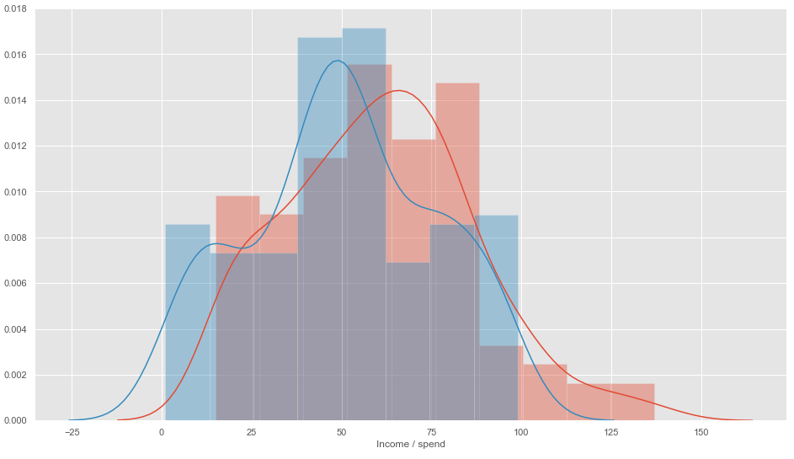
Distribution of income by spending score

Slide 9
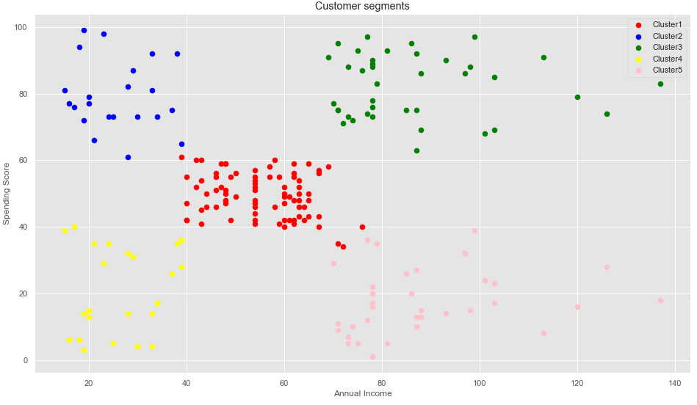
Customers segmentation by clustering
Annual x Spending Score
Cluster 1: Average Income, Average Spending
Cluster 2: Low Income, High Spending
Cluster 3: High Income, High Spending
Cluster 4: Low Income, Low Spending
Cluster 5: High Income, Low Spending

Slide 10
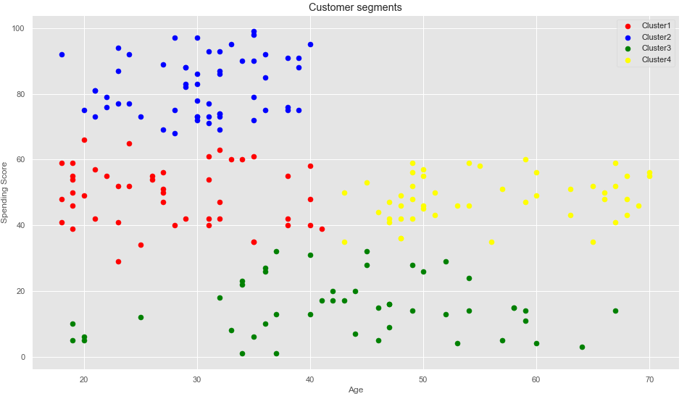
Customers segmentation by clustering
Age x Spending Score
Cluster 1: Age: 20 - 35, Average Spending
Cluster 2: Age: 20 - 40, High Spending
Cluster 3: Age: 40 - 55, Low Spending
Cluster 4: Age: 45 - 70, Average Spending

Slide 11
Conclusion
Two clusters of customers to tap;
Cluster 1: Customers with annual income between $70,000 and $100,000 and spending score is equal or greater than 70;
Cluster 1: Customers with age between 20 and 40 and spending score is equal or greater than 70;
More information (e.g.: preferred items/products, purchase seasons/period, locations, etc.) is required for further analysis on the potential customers to drive more impactful campaigns;

